Slide 1
Systems Model
Technological Systems

Slide 2
Technology System
The complete process of designing, creating, using a tool and the result of its use.
Each technology has parts that have a relationship with all other parts and to the whole.

Slide 3
Technology Systems Are:
Created from human need or want
Designed and developed by people
Modified and/or abandoned over time

Slide 4
Technology System Components
Goals- the objective, what the system should accomplish

Slide 5
Technology System Components
2. Inputs-elements that flow into the system and are consumed or processed in the system
7 different inputs
People
Materials
tools or machines
Energy
information
Finances
Time

Slide 6
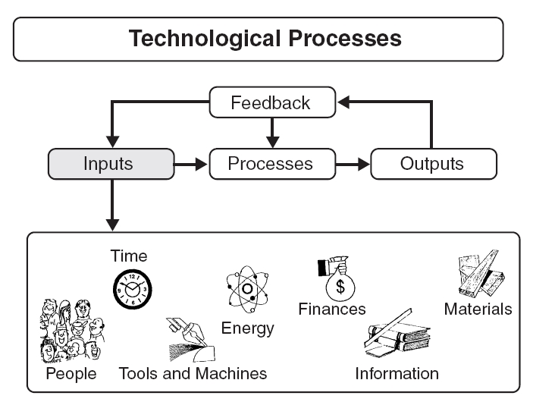
© From Technology by R. Thomas Wright, 2004

Slide 7
Technology System Components
Processes- the steps needed to complete the task
Processes
Problem
Solving
Production
Management
Engineering Design Process

Slide 8
Processes
Engineering Design Process
Define the Problem
State Constraints and Specifications
Research the Problem
Alternative Solutions
Final Solution
Model and Prototype
Testing and Evaluation
Communicate

Slide 9
Processes
Production Process-
Actions completed to produce the product, structure or service
Management Process
Controlling and supervising the people, materials, and the production of the output.

Slide 10
Technology System Components
Outputs
finished product and wastes or pollution
Can be intentional or unintentional
Feedback- Information about the output of a system used to regulate the inputs and processes

Slide 11
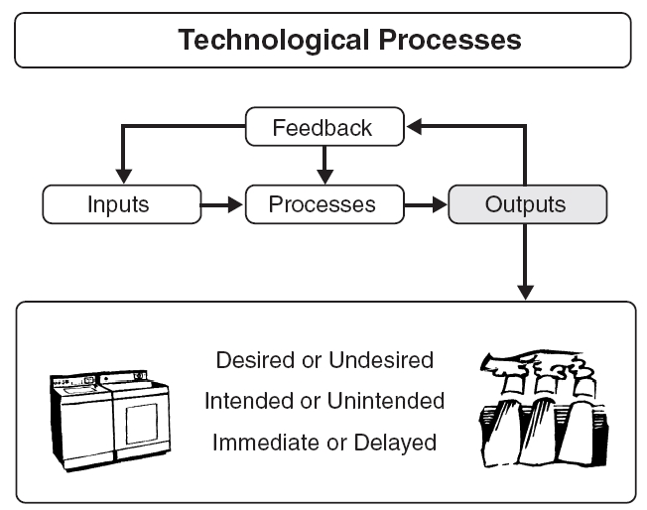
© From Technology by R. Thomas Wright, 2004

